Slide 1
Sequences and Summations

Slide 2
Sequences, Strings, Summations
A sequence or series is just like an ordered n-tuple, except:
Each element in the series has an associated index number.
A sequence or series may be infinite.
A string is a sequence of symbols from some finite alphabet.
A summation is a compact notation for the sum of all terms in a (possibly infinite) series.

Slide 3
Sequences
Definition: A sequence is a function from a subset of the natural numbers (usually of the form {0, 1, 2, . . . } to a set S.
Note: the sets {0, 1, 2, 3, . . . , k} and {1, 2, 3, 4, . . . , k} are called initial segments of .
Notation: if f is a function from {0, 1, 2, . . .} to S we usually denote f(i) by a_{i} and we write {a₀, a₁, a₂, a₃, . . . } = = where k is the upper limit (usually ∞).

Slide 4
Sequence Examples
Some authors write “the sequence a₁, a₂, …” instead of {a_{n}}, to ensure that the set of indices is clear.
Be careful: Our book often leaves the indices ambiguous.
An example of an infinite series:
Consider the series {a_{n}} = a₁, a₂, …, where (∀n≥1) a_{n}= f(n) = 1/n.
Then, we have {a_{n}} = 1, 1/2, 1/3, …

Slide 5
Example with Repetitions
Like tuples, but unlike sets, a sequence may contain repeated instances of an element.
Consider the sequence {b_{n}} = b₀, b₁, … (note that 0 is an index) where b_{n} = (−1)^{n}.
Thus, {b_{n}} = 1, −1, 1, −1, …
Note repetitions!
This {b_{n}} denotes an infinite sequence of 1’s and −1’s, not the 2-element set {1, −1}.

Slide 6
Recognizing Sequences
Sometimes, you’re given the first few terms of a sequence,
and you are asked to find the sequence’s generating function,
or a procedure to enumerate the sequence.
Examples: What’s the next number?
1,2,3,4,…
1,3,5,7,9,…
2,3,5,7,11,...
5 (the 5th smallest number >0)
11 (the 6th smallest odd number >0)
13 (the 6th smallest prime number)

Slide 7
Recurrence relations
A recurrence relation for the sequence {a_{n}} is an equation that expresses a_{n} in terms of one or more of the previous terms of the sequence, namely, a₀, a₁, . . . , a_{n−1}, for all integers n with n ≥ n₀, where n₀ is a nonnegative integer.
A sequence is called a solution of a recurrence relation if its terms satisfy the recurrence relation.

Slide 8
Example 5
Let {a_{n}} be a sequence that satisfies the recurrence relation a_{n} = a_{n-1} + 3 for n = 1, 2, 3, . . . ,and suppose that a₀ = 2. What are a₁, a₂, and a₃?
Example 6
Let {a_{n}} be a sequence that satisfies the recurrence relation a_{n} = a_{n−1} − a_{n−2} for n =2, 3, 4, . . . , and suppose that a₀ = 3 and a₁ = 5. What are a₂ and a₃?

Slide 9
The initial conditions for a recursively defined sequence specify the terms that precede the first term where the recurrence relation takes effect.

Slide 10
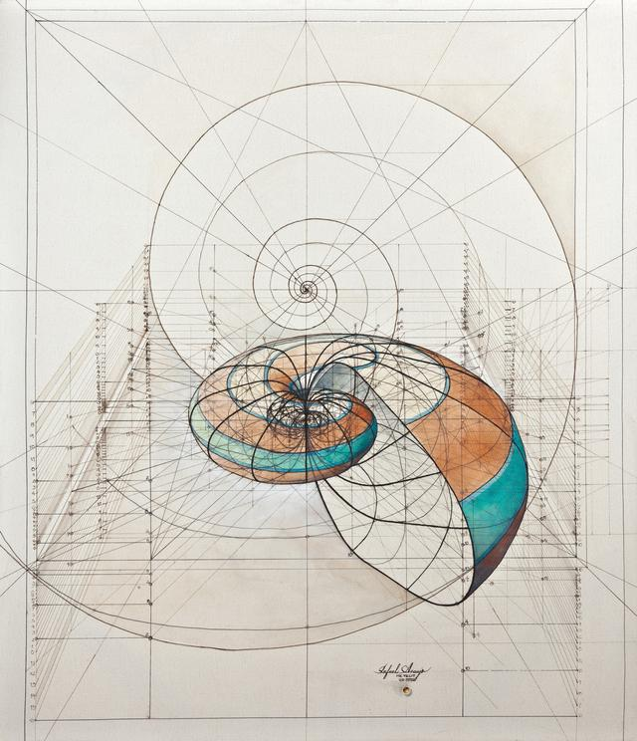
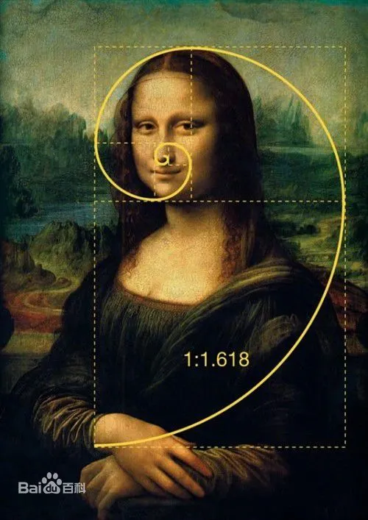
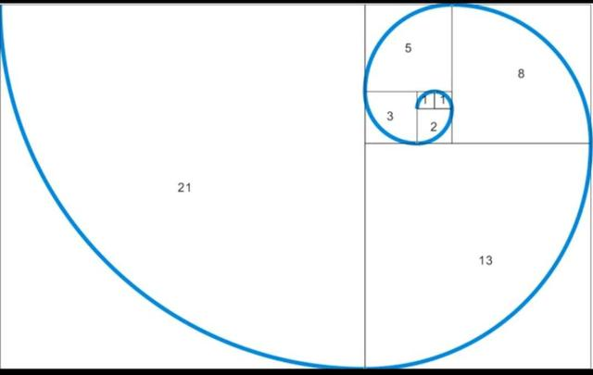
The Fibonacci sequence, f₀, f₁, f₂, . . . , is defined by the initial conditions f₀ = 0, f₁ = 1, and the recurrence relation f_{n} = f_{n−1} + f_{n−2} for n = 2, 3, 4, . . . .
EXAMPLE 7
Find the Fibonacci numbers f₂, f₃, f₄, f₅, and f₆.

Slide 11
Example 8
Suppose that {a_{n}} is the sequence of integers defined by a_{n} = n!, the value of the factorial function at the integer n, where n = 1, 2, 3, . . ..
n! = n((n − 1)(n − 2) . . . 2 ・ 1) =n(n − 1)! = na_{n−1},
we see that the sequence of factorials satisfies the recurrence relation a_{n} = na_{n−1}, together with the initial condition a₁ = 1.

Slide 12
We say that we have solved the recurrence relation together with the initial conditions when we find an explicit formula, called a closed formula, for the terms of the sequence.

Slide 13
EXAMPLE 9
Determine whether the sequence {a_{n}}, where a_{n} = 3n for every nonnegative integer n, is a solution of the recurrence relation a_{n} = 2a_{n−1} − a_{n−2} for n = 2, 3, 4, . . . .
Answer the same question where a_{n} = 2^{n} and where a_{n} = 5.
a_{n}= 2×3(n-1)-3(n-2)=6n-6-3n+6=3n
a_{n}= 2×2^{n-1} - 2^{n-2}= 3×2^{n-2}

Slide 14
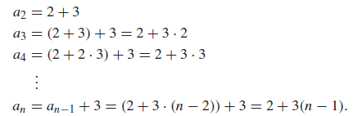
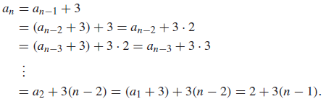
EXAMPLE 10
Solve the recurrence relation and initial condition in Example 5.

Slide 15
The technique used in Example 10 is called iteration.
The first approach is called forward substitution – we found successive terms beginning with the initial condition and ending with a_{n}.
The second approach is called backward substitution, because we began with an and iterated to express it in terms of falling terms of the sequence until we found it in terms of a₁.

Slide 16
Special integer sequences
Example 12
Find formulae for the sequences with the following first five terms:
(a) 1, 1/2, 1/4, 1/8, 1/16
(b) 1, 3, 5, 7, 9
(c) 1, −1, 1, −1, 1.
Example 13
How can we produce the terms of a sequence if the first 10 terms are 1, 2, 2, 3, 3, 3, 4, 4, 4, 4?

Slide 17
Special integer sequences
Example 14
How can we produce the terms of a sequence if the first 10 terms are 5, 11, 17, 23, 29, 35, 41,47, 53, 59?
Example 15
How can we produce the terms of a sequence if the first 10 terms are 1, 3, 4, 7, 11, 18, 29, 47, 76, 123?
a_{n}=a_{n-1}+a_{n-2} with a₀=2, a₁=1

Slide 18
Summation Notation
Given a series {a_{n}}, an integer lower bound (or limit) j≥0, and an integer upper bound k≥j, then the summation of {a_{n}} from j to k is written and defined as follows:
Here, i is called the index of summation.

Slide 19
Generalized Summations
For an infinite series, we may write:
To sum a function over all members of a set X={x₁, x₂, …}:
Or, if X={x|P(x)}, we may just write:

Slide 20
Simple Summation Example

Slide 21
More Summation Examples
An infinite series with a finite sum:
Using a predicate to define a set of elements to sum over:

Slide 22
Summation Manipulations
Some handy identities for summations:
(Distributive law.)
(An application of commut- ativity.)
(Index shifting.)

Slide 23
More Summation Manipulations
Other identities that are sometimes useful:
(Series splitting.)
(Order reversal.)
(Grouping.)

Slide 24
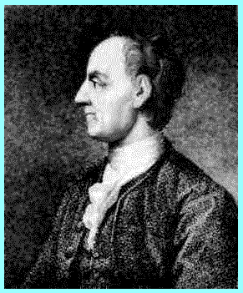
Example: Impress Your Friends
Boast, “I’m so smart; give me any 2-digit number n, and I’ll add all the numbers from 1 to n in my head in just a few seconds.”
I.e., Evaluate the summation:
There is a simple closed-form formula for the result, discovered by Euler at age 12!
And frequently rediscovered by many…
Leonhard Euler (1707-1783)

Slide 25
Euler’s Trick, Illustrated
Consider the sum: 1+2+…+(n/2)+((n/2)+1)+…+(n-1)+n
We have n/2 pairs of elements, each pair summing to n+1, for a total of (n/2)(n+1).
n+1
…
n+1
n+1

Slide 26
Symbolic Derivation of Trick
For case where n is even…

Slide 27
Concluding Euler’s Derivation
So, you only have to do 1 easy multiplication in your head, then cut in half.
Also works for odd n (prove this at home).

Slide 28
Example: Geometric Progression
A geometric progression is a series of the form a, ar, ar², ar³, …, ar^{k}, where a,r∈R.
The sum of such a series is given by:
We can reduce this to closed form via clever manipulation of summations...

Slide 29
Geometric Sum Derivation
Here we go...

Slide 30
Derivation example cont...

Slide 31
Concluding long derivation...

Slide 32
Nested Summations
These have the meaning you’d expect.
Note issues of free vs. bound variables, just like in quantified expressions, integrals, etc.

Slide 33
Some Shortcut Expressions
Geometric series.
Euler’s trick.
Quadratic series.
Cubic series.

Slide 34
Using the Shortcuts
Example: Evaluate .
Use series splitting.
Solve for desired summation.
Apply quadratic series rule.
Evaluate.

Slide 35
Summations: Conclusion
You need to know:
How to read, write & evaluate summation expressions like:
Summation manipulation laws we covered.
Shortcut closed-form formulas, & how to use them.

Slide 36
Homework
§2.4
6(a,c,e,g), 12(a,d), 18,
26(a,f), 30(b,d), 34(b)

Slide 37
Cardinality of Sets

Slide 38
Cantor’s Definition (1874)
Two sets are defined to have the same (size) cardinality （基数）
if and only if
They can be placed into 1-1 onto correspondence.

Slide 39
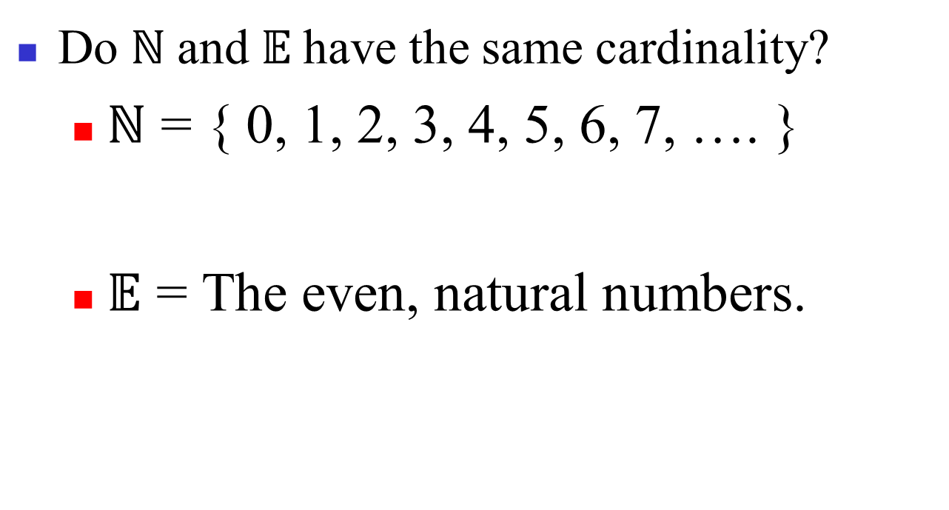
Same cardinality?

Slide 40
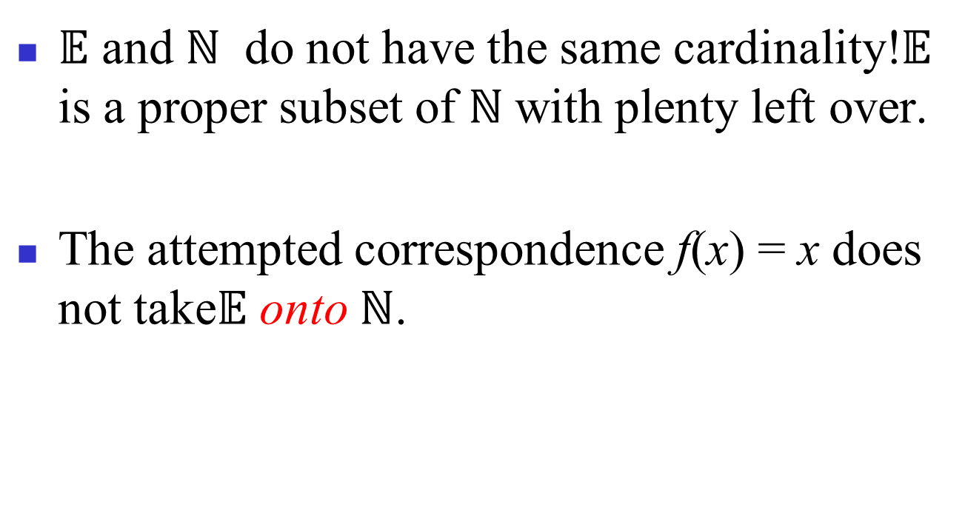
Same cardinality?

Slide 41
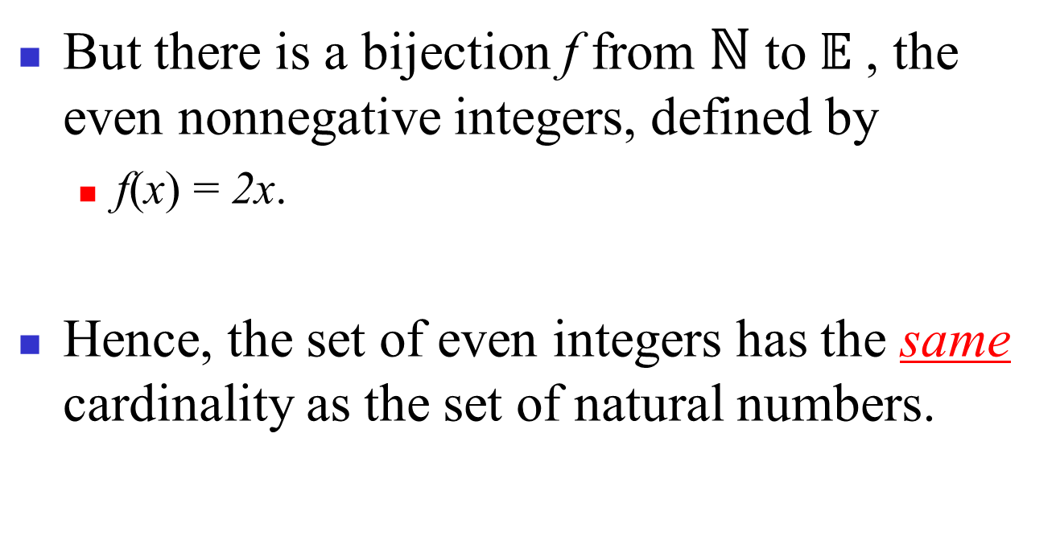
Same cardinality?

Slide 42
Lesson
Cantor’s definition only requires that some 1-1 correspondence between the two sets is onto, not that all 1-1 correspondences are onto.
This distinction never arises when the sets are finite.

Slide 43
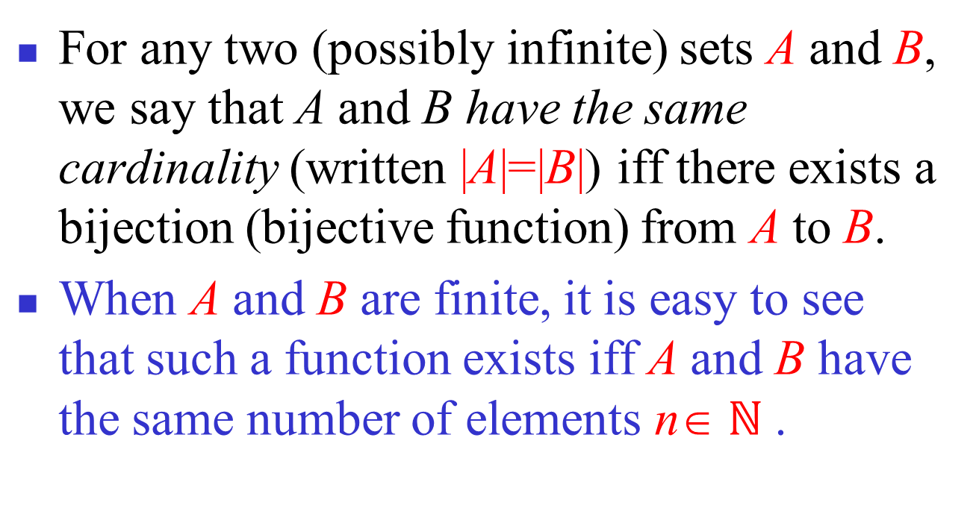
Cardinality: Formal Definition

Slide 44
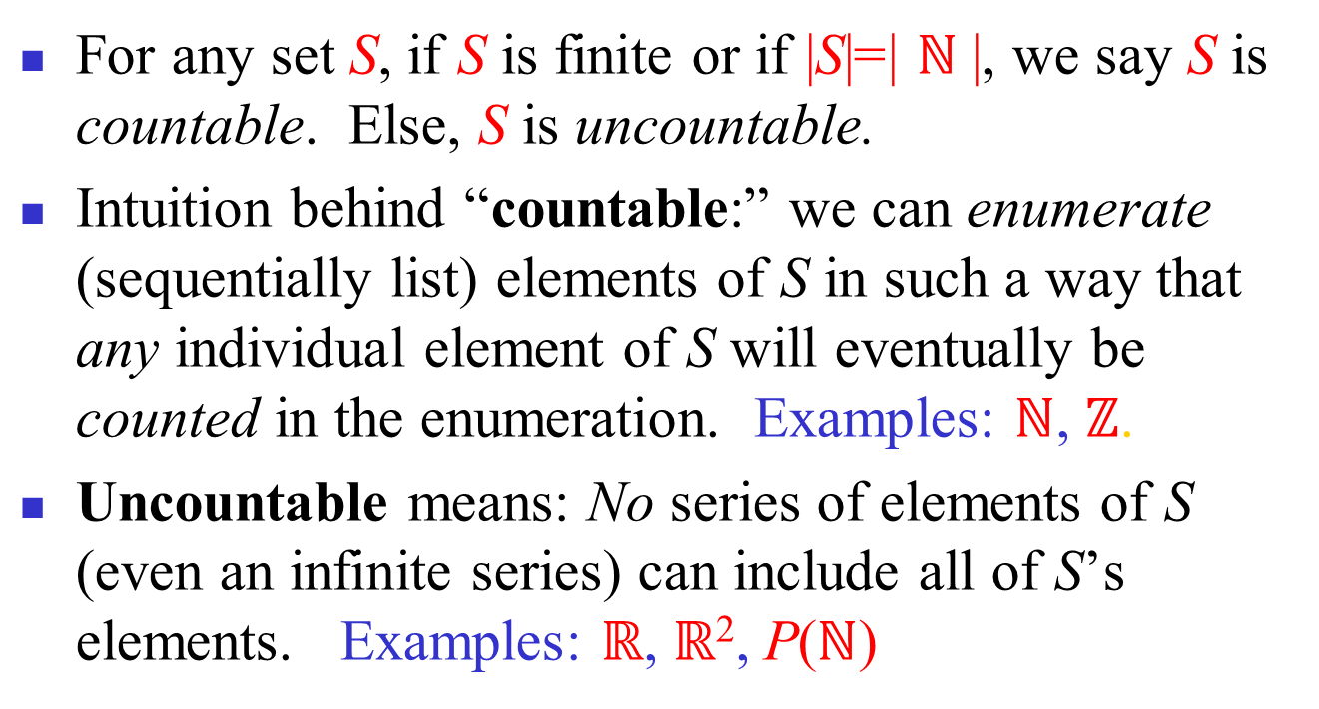
Countable versus Uncountable

Slide 45
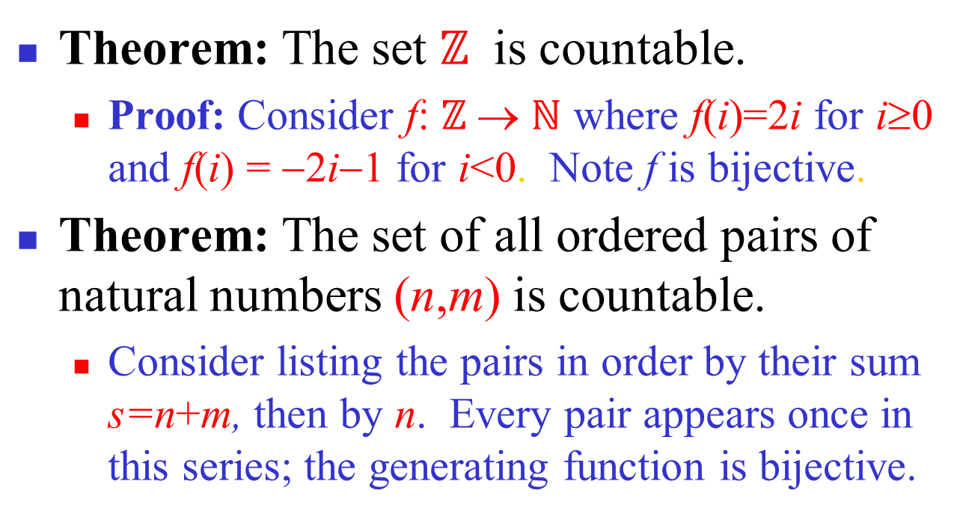
Countable Sets: Examples

Slide 46
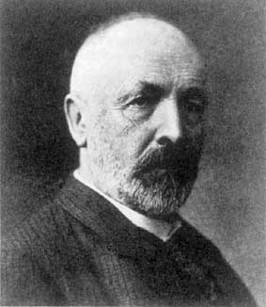
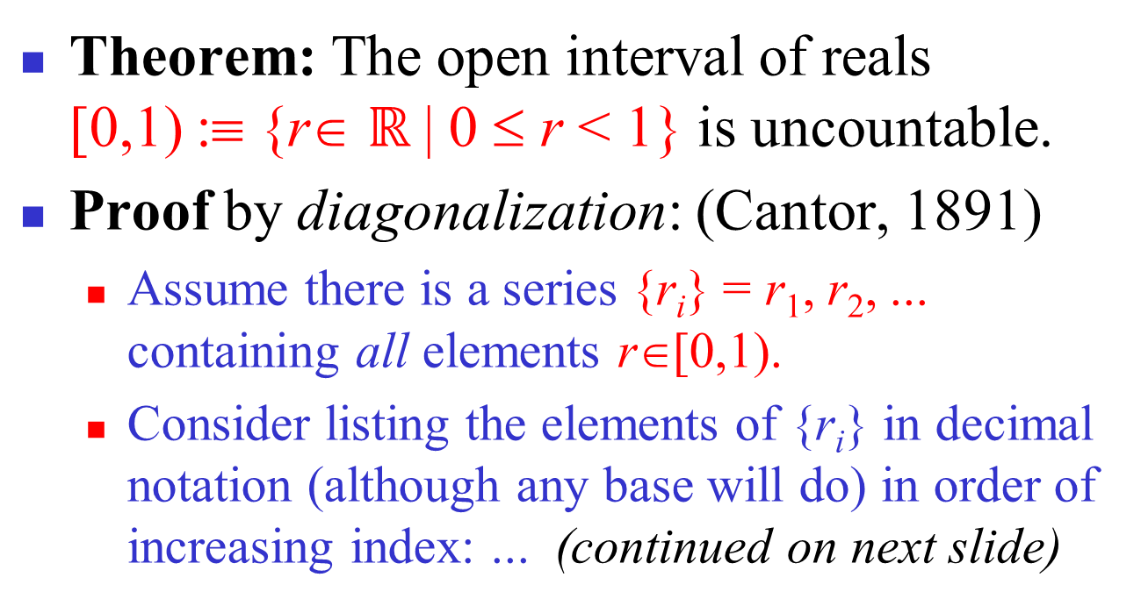
Uncountable Sets: Example
Georg Cantor
1845-1918

Slide 47
Uncountability of Reals, cont’d
A postulated enumeration of the reals: r₁ = 0.d_{1,1} d_{1,2} d_{1,3} d_{1,4} d_{1,5} d_{1,6} d_{1,7} d_{1,8}… r₂ = 0.d_{2,1} d_{2,2} d_{2,3} d_{2,4} d_{2,5} d_{2,6} d_{2,7} d_{2,8}… r₃ = 0.d_{3,1} d_{3,2} d_{3,3} d_{3,4} d_{3,5} d_{3,6} d_{3,7} d_{3,8}… r₄ = 0.d_{4,1} d_{4,2} d_{4,3} d_{4,4} d_{4,5} d_{4,6} d_{4,7} d_{4,8}… . . .
Now, consider a real number generated by taking all the digits d_{i,i} that lie along the diagonal in this figure and replacing them with different digits.
That real doesn't appear in the list!
Notes:
Why? Because it’s first digit is different from the first digit of r1, its second digit is different from the second digit of r2, and in general its nth digit is different from the nth digit of rn. Therefore it is different from every number in the list. We may want to restrict ourselves to change the digit to one other than 9 because if we change it to a nine, the resulting number could be say .1239999999999… infinitely which is equal to .1240000000000… (which could be in the list) even though the digits don’t match. But, actually this imagined problem doesn’t actually arise because since there are an infinite number of reals that don’t include any 9’s, it is impossible for the diagonal to be all 9’s beyond some finite point.

Slide 48
Uncountability of Reals, fin.
E.g., a postulated enumeration of the reals: r₁ = 0.301948571… r₂ = 0.103918481… r₃ = 0.039194193… r₄ = 0.918237461…
OK, now let’s add 1 to each of the diagonal digits (mod 10), that is changing 9’s to 0.
0.4103… can’t be on the list anywhere!

Slide 49
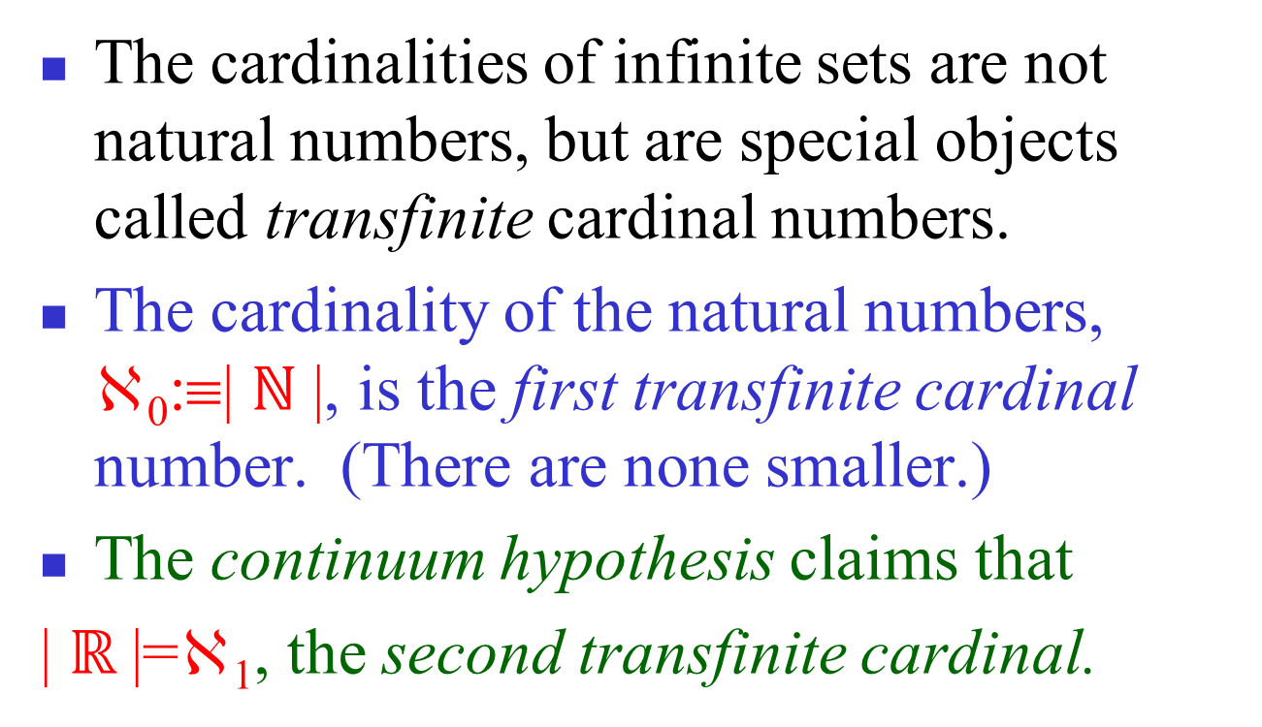
Transfinite Numbers
Proven impossible to prove or disprove!
Notes:
In other words, the continuum hypothesis has been shown to be independent from the other axioms of set theory that led to the definition of transfinite cardinals.

Slide 50
Countable vs. Uncountable
You should:
Know how to define “same cardinality” in the case of infinite sets.
Know the definitions of countable and uncountable.
Know how to prove (at least in easy cases) that sets are either countable or uncountable.

Slide 51
Homework
§2.5
2, 10

Slide 52
Matrices（矩阵）

Slide 53
§2.6 Matrices
A matrix is a rectangular array of objects (usually numbers).
An m×n (“m by n”) matrix has exactly m horizontal rows, and n vertical columns.
Plural of matrix = matrices (say MAY-trih-sees)
An n×n matrix is called a square matrix, whose order or rank is n.
a 3×2 matrix
Note: The singular form of “matrices” is “matrix,” not “MAY-trih-see”!

Slide 54
Applications of Matrices
Tons of applications, including:
Solving systems of linear equations
Computer Graphics, Image Processing
Models within many areas of Computational Science & Engineering
Quantum Mechanics, Quantum Computing
Many, many more…

Slide 55
Matrix Equality
Two matrices A and B are considered equal iff they have the same number of rows, the same number of columns, and all their corresponding elements are equal.

Slide 56
Row and Column Order
The rows in a matrix are usually indexed 1 to m from top to bottom. The columns are usually indexed 1 to n from left to right. Elements are indexed by row, then column.

Slide 57
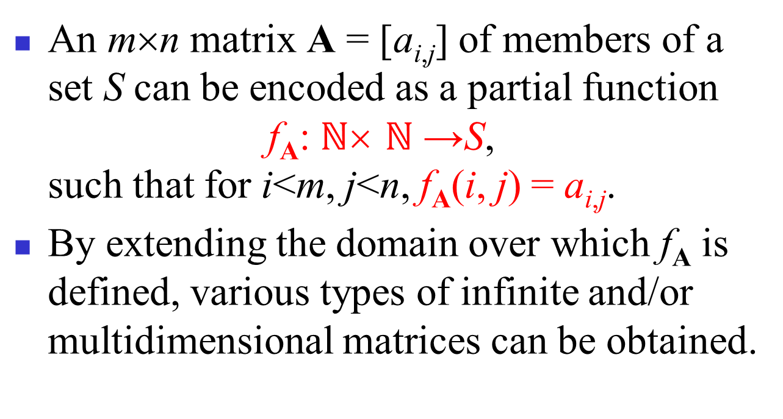
Matrices as Functions

Slide 58
Matrix Sums
The sum A+B of two matrices A, B (which must have the same number of rows, and the same number of columns) is the matrix (also with the same shape) given by adding corresponding elements of A and B.
A+B = [a_{i,j}+b_{i,j}]

Slide 59
Matrix Products
For an m×k matrix A and a k×n matrix B, the product AB is the m×n matrix:
I.e., the element of AB indexed (i,j) is given by the vector dot product of the ith row of A and the jth column of B (considered as vectors).
Note: Matrix multiplication is not commutative!

Slide 60
Matrix Product Example
An example matrix multiplication to practice in class:

Slide 61
Identity Matrices
The identity matrix of order n, I_{n}, is the rank-n square matrix with 1’s along the upper-left to lower-right diagonal, and 0’s everywhere else.
∀1≤i,j≤n
n
Kronecker Delta
n

Slide 62
Matrix Inverses
For some (but not all) square matrices A, there exists a unique multiplicative inverse A⁻¹ of A, a matrix such that A⁻¹A = I_{n}.
If the inverse exists, it is unique, and A⁻¹A = AA⁻¹.
We won’t go into the algorithms for matrix inversion...

Slide 63
Matrix Multiplication Algorithm
procedure matmul(matrices A: m×k, B: k×n)
for i := 1 to m
for j := 1 to n begin
c_{ij} := 0
for q := 1 to k
c_{ij} := c_{ij} + a_{iq}b_{qj}
end {C=[c_{ij}] is the product of A and B}
Θ(m)·
What’s the Θ of its time complexity?
Θ(n)·(
Answer: Θ(mnk)
Θ(1)+
Θ(k) ·
Θ(1))

Slide 64
Powers of Matrices
If A is an n×n square matrix and p≥0, then:
A^{p} :≡ AAA···A (and A⁰ :≡ I_{n})
Example:
p times

Slide 65
Matrix Transposition
If A=[a_{ij}] is an m×n matrix, the transpose of A (often written A^{t} or A^{T}) is the n×m matrix given by A^{t} = B = [b_{ij}] = [a_{ji}] (1≤i≤n,1≤j≤m)
Flip across diagonal

Slide 66
Symmetric Matrices
A square matrix A is symmetric iff A=A^{t}. I.e., ∀i,j≤n: a_{ij} = a_{ji} .
Which of the below matrices is symmetric?

Slide 67
Zero-One Matrices
Useful for representing other structures.
E.g., relations, directed graphs (later in this course)
All elements of a zero-one matrix are either 0 or 1
Representing False & True respectively.
The join of A, B (both m×n zero-one matrices):
A∨B :≡ [a_{ij}∨b_{ij}]
The meet of A, B:
A∧B :≡ [a_{ij}∧b_{ij}] = [a_{ij} b_{ij}]
The 1’s in A join the 1’s in B to make up the 1’s in C.
Where the 1’s in A meet the 1’s in B, we find 1’s in C.

Slide 68
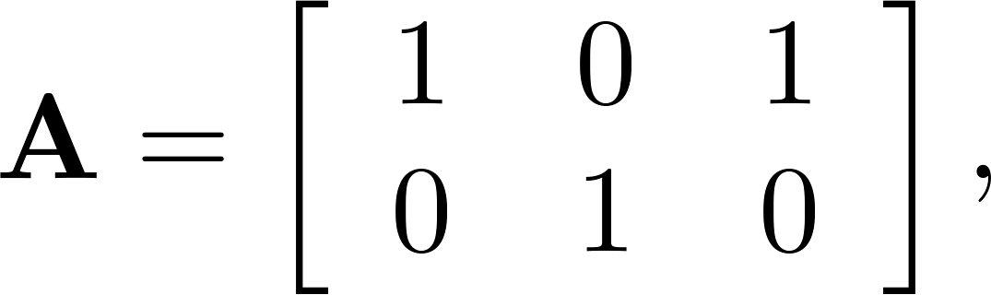
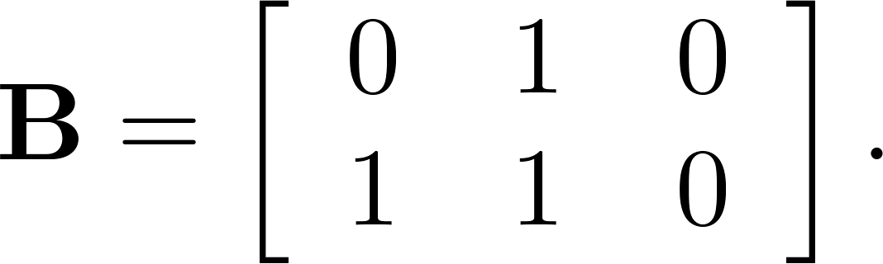
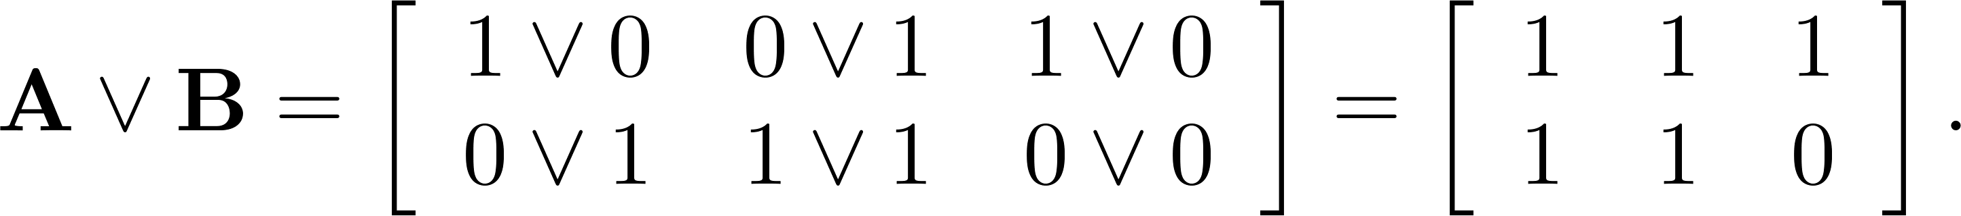
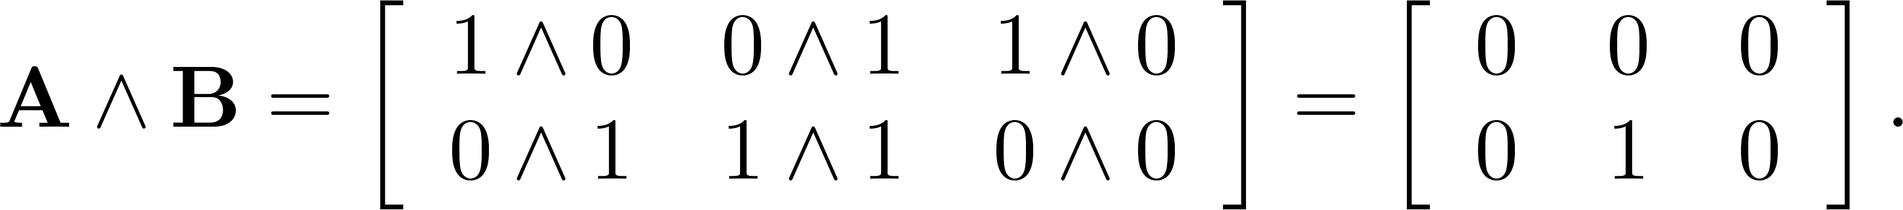
Joins and Meets of Zero-One Matrices
Example: Find the join and meet of the zero-one matrices
Solution: The join of A and B is
The meet of A and B is

Slide 69
Boolean Products
Let A=[a_{ij}] be an m×k zero-one matrix, & let B=[b_{ij}] be a k×n zero-one matrix,
The boolean product of A and B is like normal matrix ×, but using ∨ instead of + in the row-column “vector dot product”:
A⊙B

Slide 70
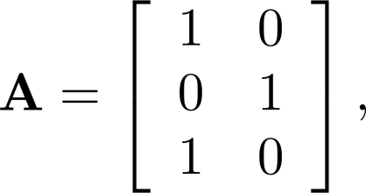
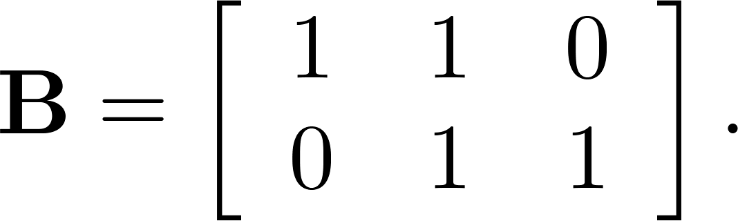
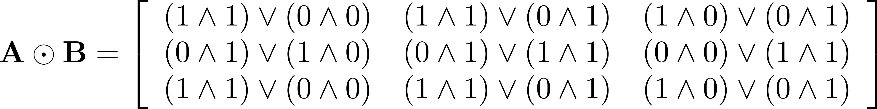
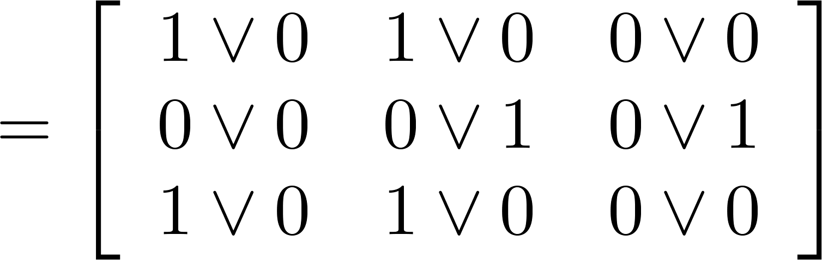
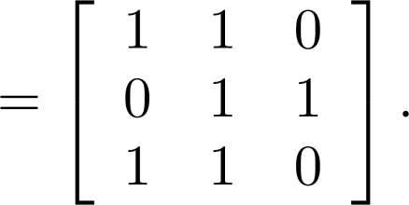
Boolean Product of Zero-One Matrices
c_{ij} = (a_{i1} ∧ b_{1j})∨ (a_{i2} ∧ b_{2j}) ∨ … ∨ (a_{ik} ∧ b_{kj}).
Example: Find the Boolean product of A and B, where
Solution: The Boolean product A ⊙ B is given by

Slide 71
Boolean Powers
For a square zero-one matrix A, and any k≥0, the kth Boolean power of A is simply the Boolean product of k copies of A.
A^{[k]} :≡ A⊙A⊙…⊙A
A^{[0]} :≡ I_{n}
k times

Slide 72
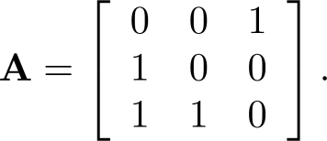
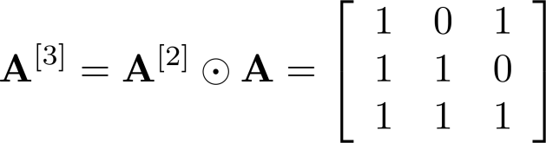
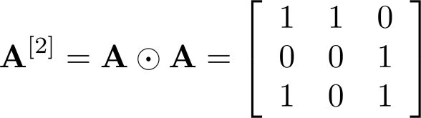
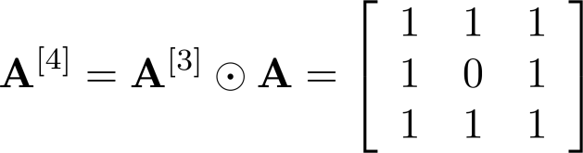
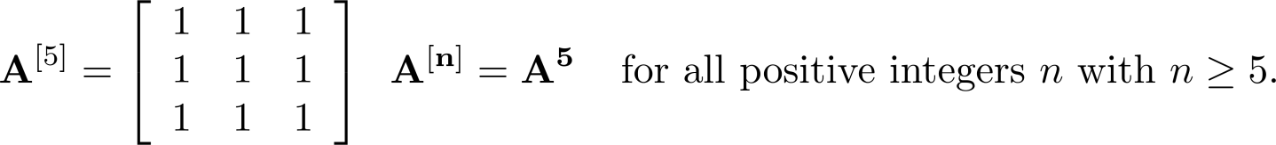
Boolean Powers of Zero-One Matrices
Example: Let
Find A^{n} for all positive integers n.
Solution:

Slide 73
Basic properties of the Boolean matrix
If A, B, and C are Boolean matrices of compatible sizes, then

Slide 74
Homework
§2.6
4（b）, 20, 28, 32

